Slide 1

Project Title -
[NIKHIL MADAAN
College Name - Om Sterling Global University ]
AICTE STU ID : (STU6a6b4eb4a05bb1785417396)

Slide 2

PROBLEM STATEMENT
(Agricultural activities are influenced by seasonal variations in environmental conditions, farming practices, resource availability and market conditions. As a result, agricultural performance may differ from one season to another. However, raw agricultural data does not clearly explain how agricultural performance changes across seasons or what patterns can be observed in different seasonal conditions. The problem is to analyze the given agricultural dataset and investigate seasonal differences in agricultural performance by identifying meaningful patterns, trends, relationships and variations within the available data.

Slide 3
Project Description This project analyzes agricultural data across different seasons, crops, states, and farming conditions. It studies yield, production, environmental factors, resource usage, irrigation, market prices, revenue, and profit to identify meaningful patterns and relationships. The analysis uses Python, statistical methods, and data visualizations to understand seasonal performance and provide evidence-based insights for better agricultural planning.

Slide 4

WHO ARE THE END USERS?
Farmers – To understand which crops perform better in different seasons.
Agricultural Planners – To plan farming activities based on seasonal results.
Researchers – To study crop, weather, and farming patterns.
Agricultural Analysts – To compare crops, states, and seasons using data.
Irrigation Managers – To understand water usage and irrigation performance.
Government Departments – To support better agricultural planning and decisions.
Resource Managers – To understand the use of water, fertilizer, and pesticides.

Slide 5

Technology Used
Python – Used for performing the overall data analysis.
Pandas – Used for loading, cleaning, and analyzing the dataset.
NumPy – Used for numerical calculations.
Matplotlib – Used to create charts and graphs.
Seaborn – Used to create attractive data visualizations and heatmaps.
SciPy – Used for statistical analysis such as ANOVA.
Jupyter Notebook / Google Colab – Used to write, run, and document the complete analysis.
CSV Dataset – Used as the main source of agricultural data.

Slide 6
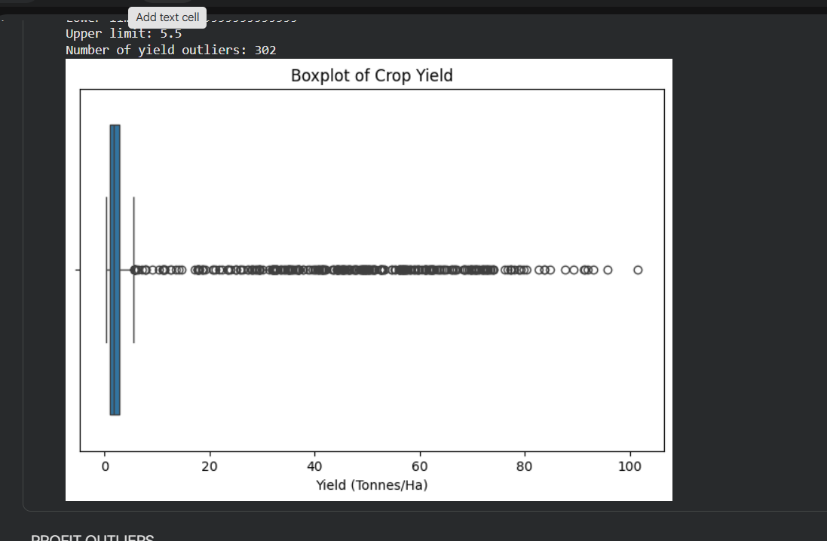
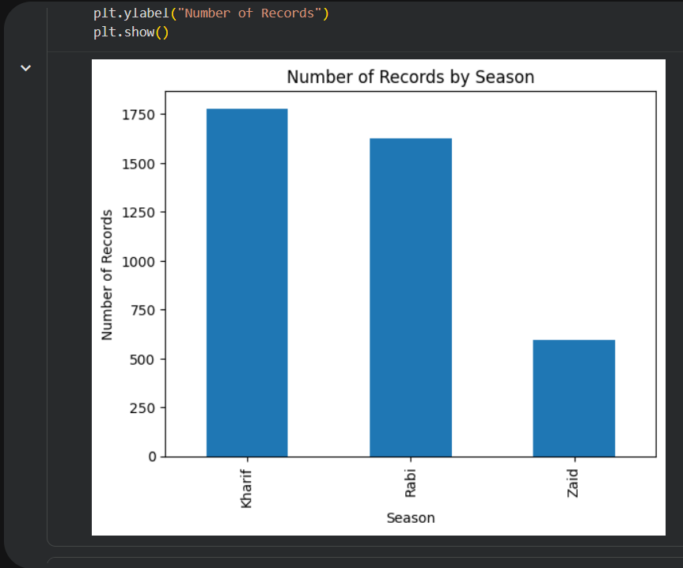
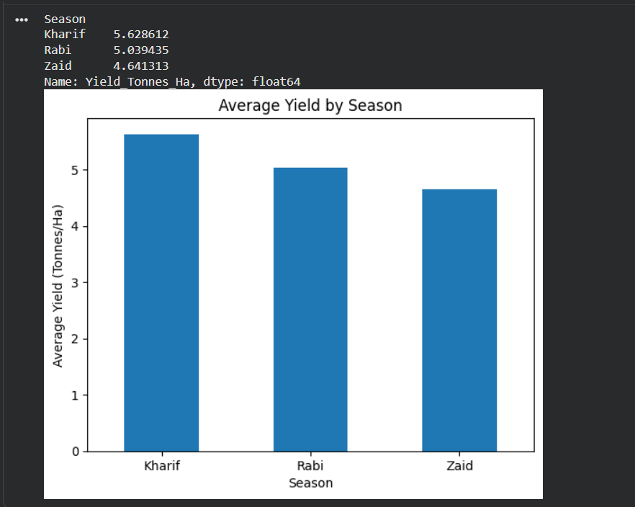
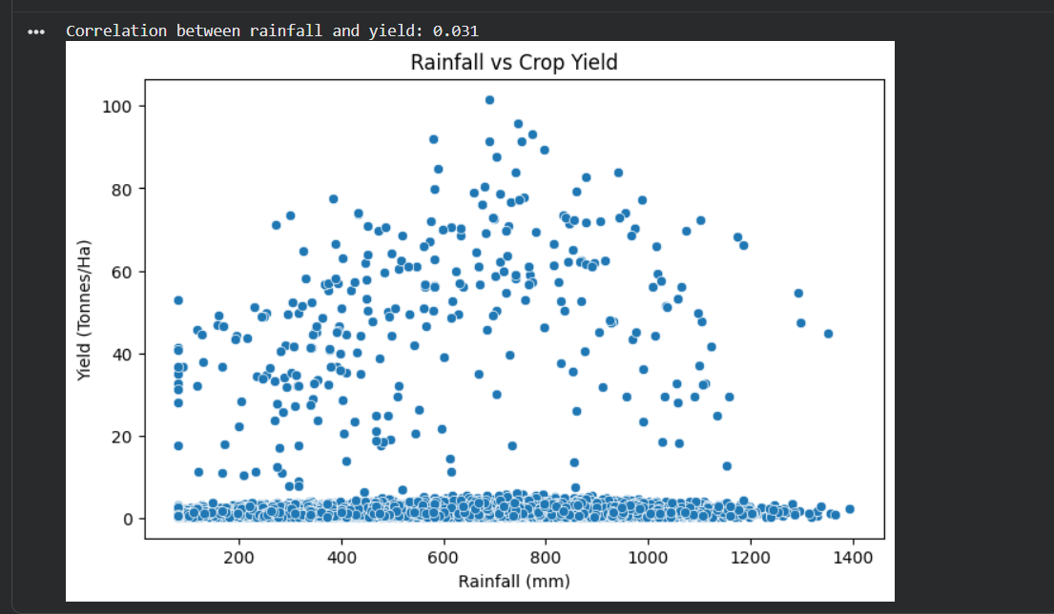
RESULTS

Slide 7
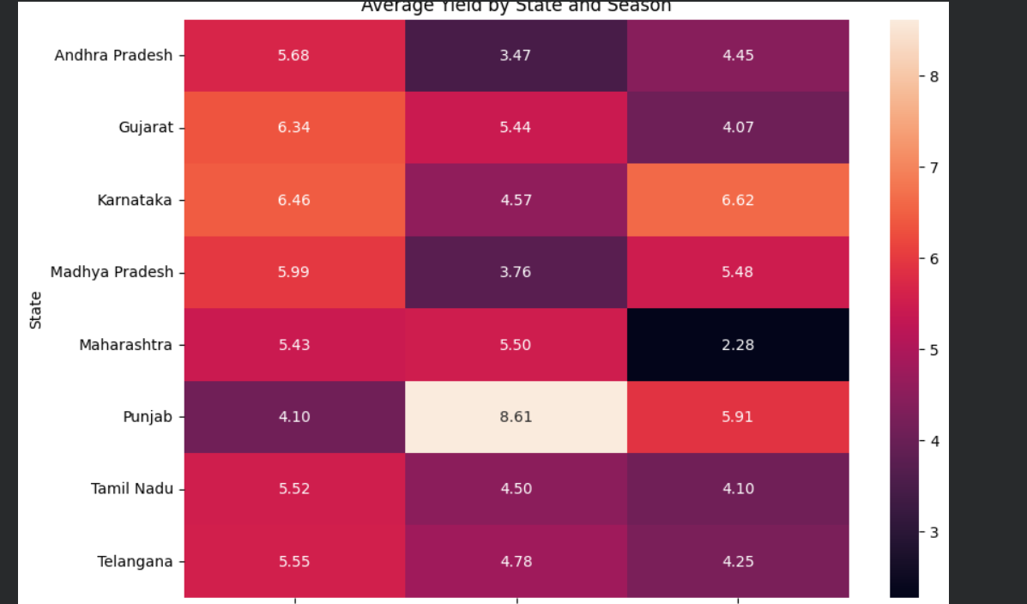
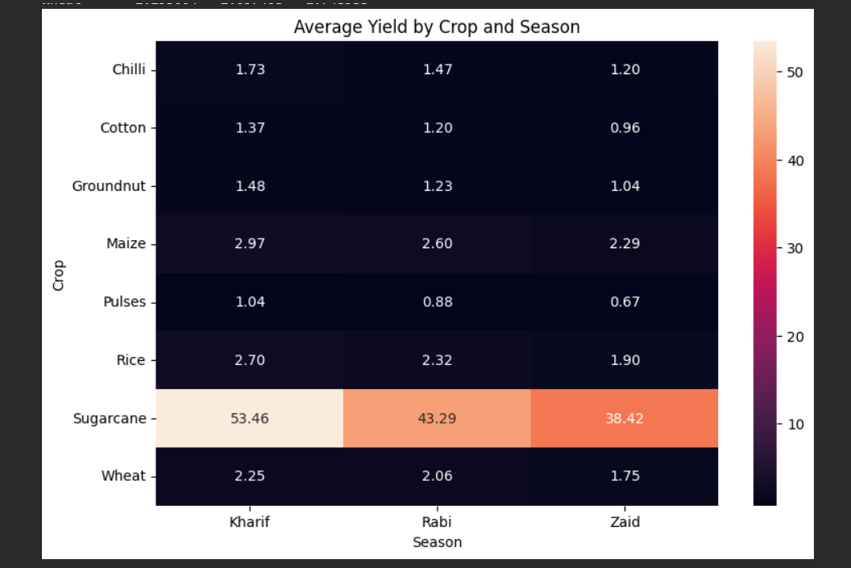
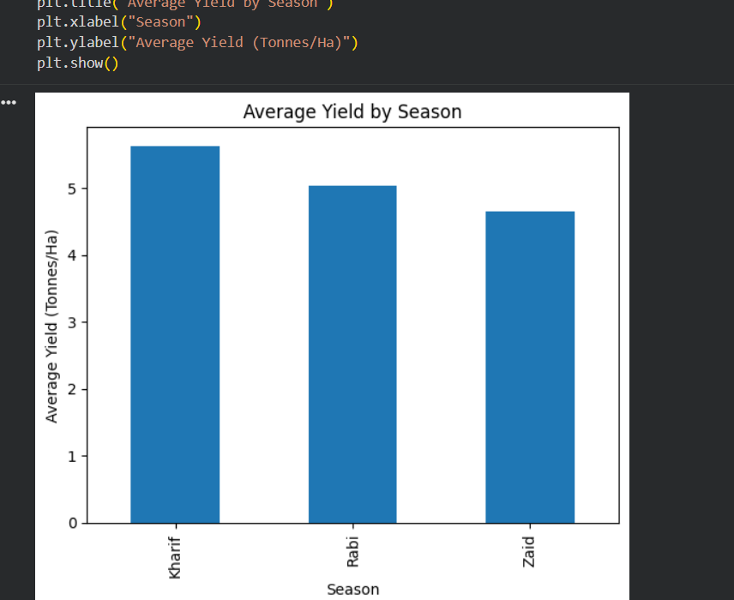
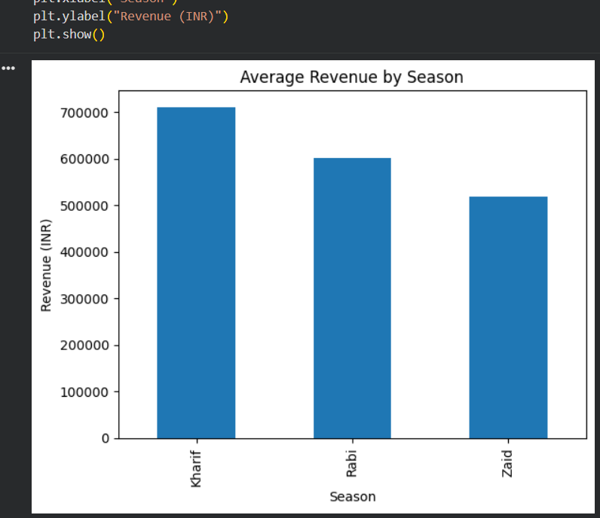
RESULTS

Slide 8
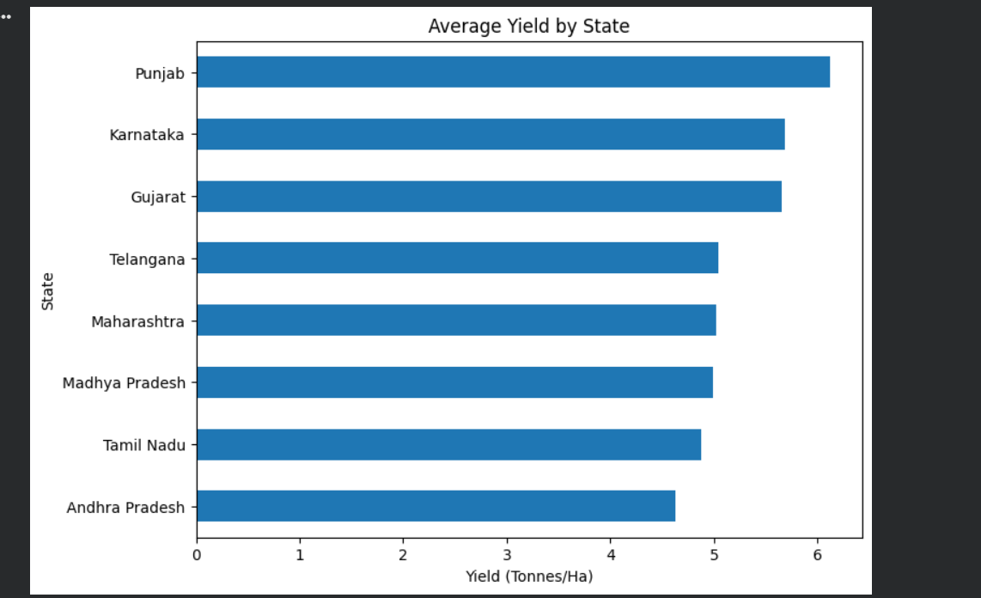
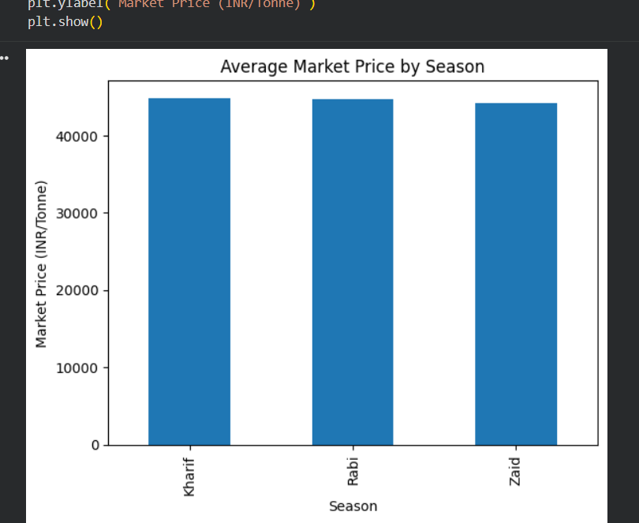

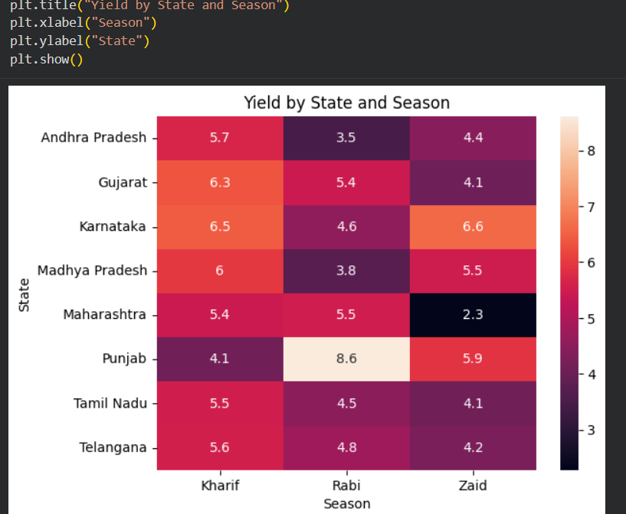
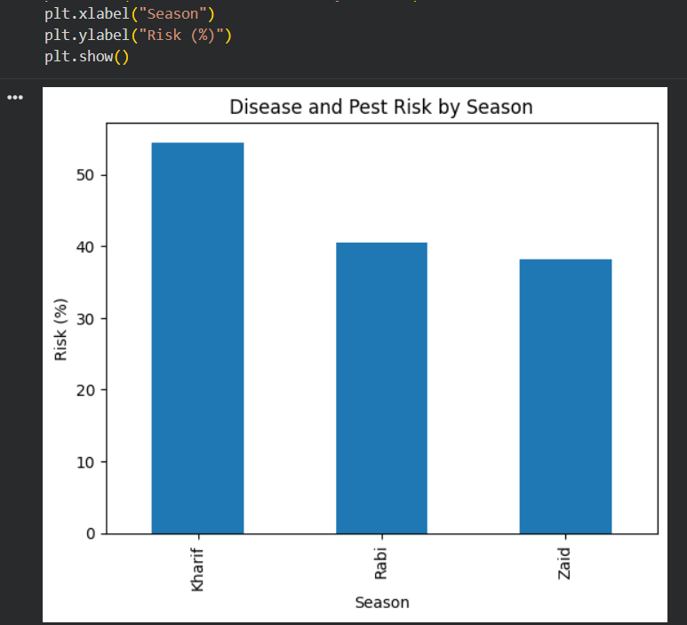
RESULTS

Slide 9
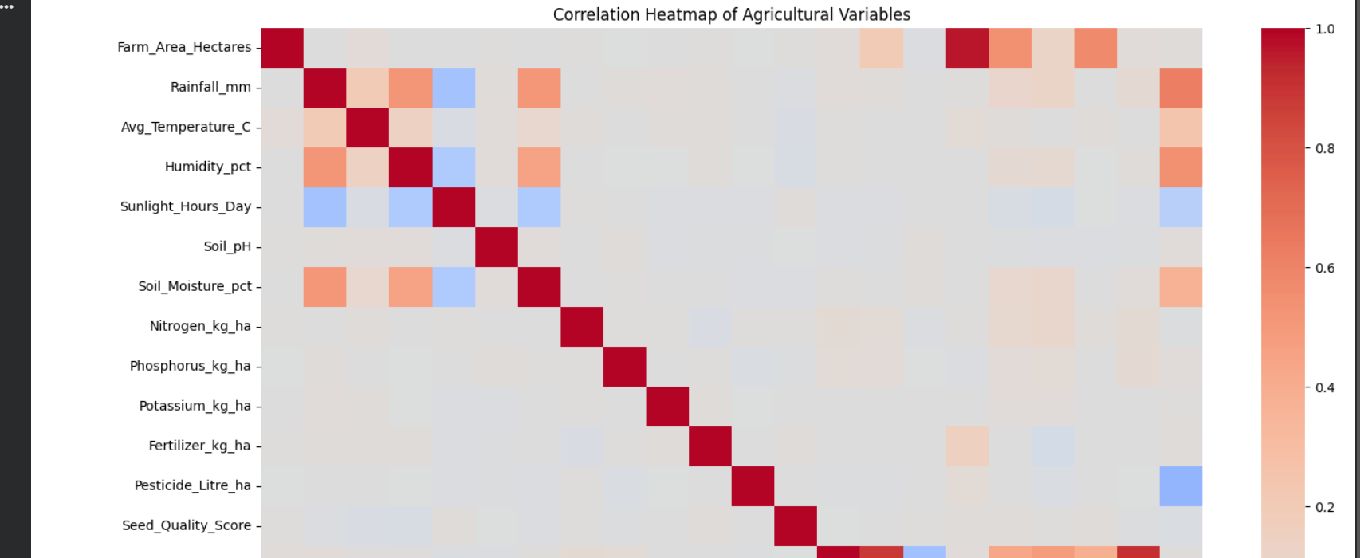
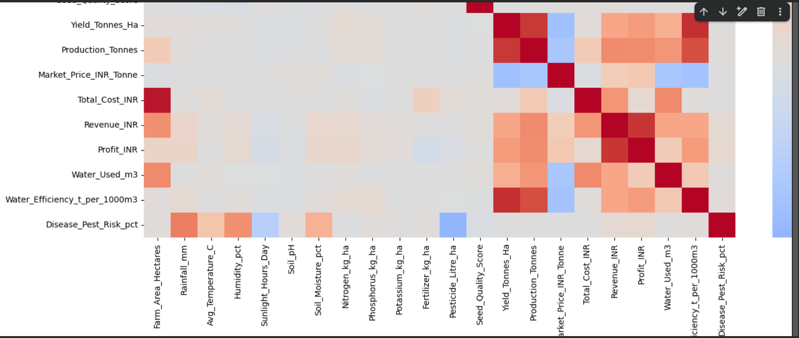
RESULTS

Slide 10
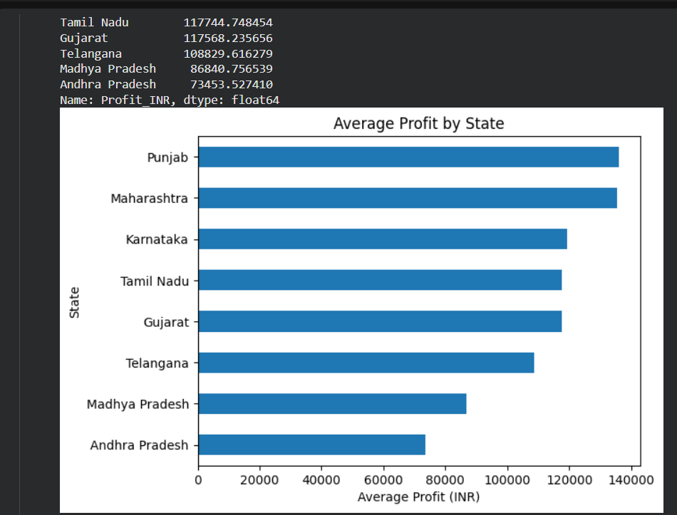
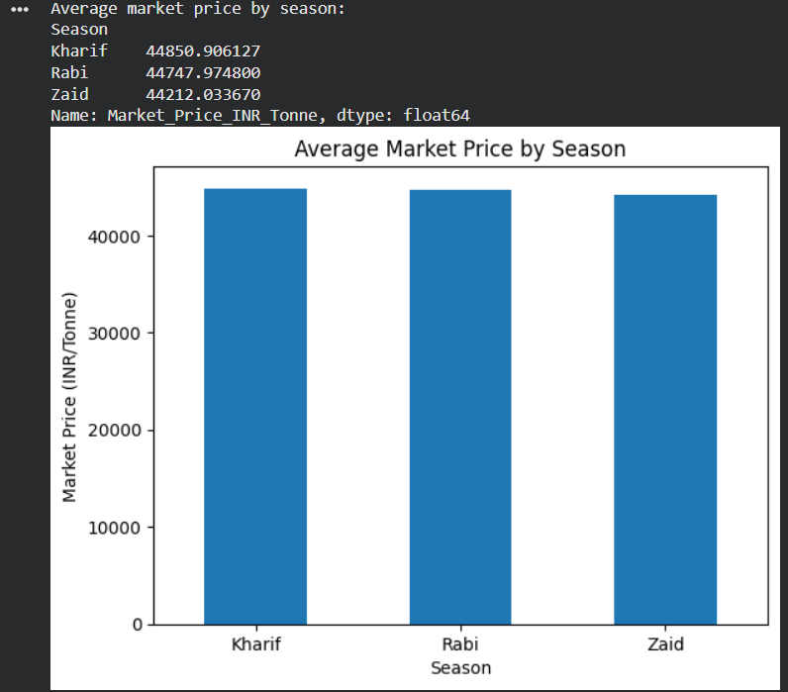
RESULTS

Slide 11
Future scope
Yield Prediction: In future, we can use machine learning to predict crop yield for different seasons.
Weather Data: We can add live weather data like rainfall, temperature, and humidity to get better results.
Smart Irrigation: We can make a system that helps farmers choose the best irrigation method and save water.
Disease Prediction: We can predict the chances of crop diseases and pests using the available data.
More Data: We can add more states, districts, crops, and seasons to make the project bigger and more useful.
Dashboard: We can create a simple Power BI or Tableau dashboard so users can easily see the results.
Better Planning: The results can help farmers and agriculture departments make better plans for different seasons.

Slide 12
GitHub Link
https://github.com/nikhilmadaan2024-star/Seasonal-Agriculture-Performance-Analysis.git
https://github.com/nikhilmadaan2024-star/Seasonal-Agriculture-Performance-Analysis.git

Slide 13
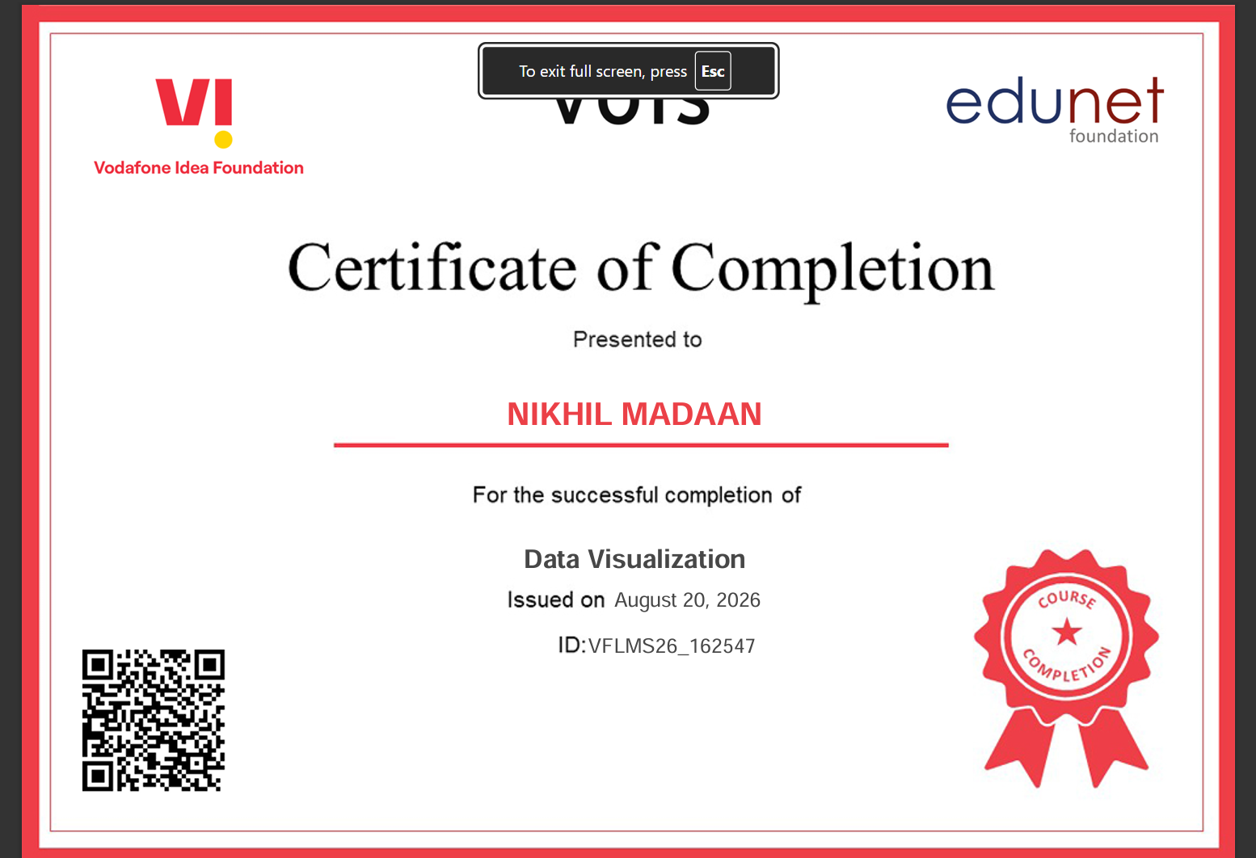
VOIS Course completion certificate - Course name- Data Visualization

Slide 14
Thank you
.
.

